Slide 1
Grant Issues: Informatics
Adapted for DMC meeting
8-15-22
Issues: #3, #5

Slide 2
Overview
Introduction to SALURBAL data infrastructure work
Some insights

Slide 3
SALURBAL: Goal
BR
BRR
MX
MX
CL
CL
PE
PE
Input:
raw data (census/survey…ETC) from 11 countries in Latin-America
Output:
Harmonized datasets from which we can do analysis that spans across countries

Slide 4
SALURBAL: What we did
Mortality (Jane)
Methodology was excellent across working groups
Lack of infrastructure standards across working groups: data format, variable naming conventions, codebook format, codebook content, file structures…
Income (Jeff)
Health (James)

Slide 5
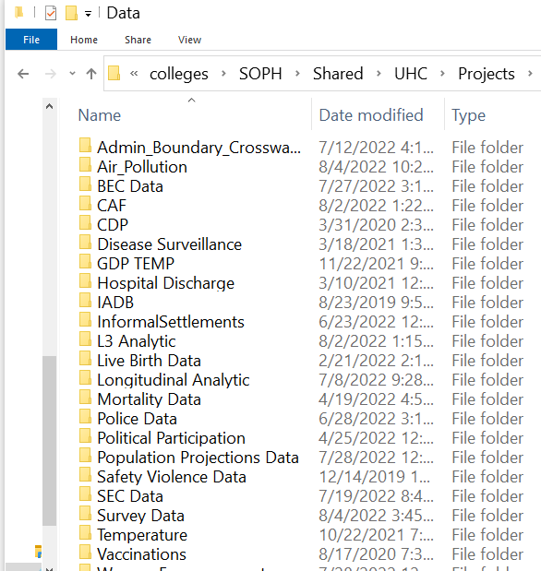
SALURBAL: What we did
Mortality (Jane)
Methodology was excellent across working groups
Lack of infrastructure standards across working groups: data format, variable naming conventions, codebook format, codebook content, file structures…
The final output was stored in separate folders
Income (Jeff)
Health (James)

Slide 6

🤕 #1 Lack of transparency to data available
What data is available?
Do I have to click every folder individually and check every data file?
Users
(researchers)

Slide 7

🤕 #2 Data access is human intensive
Mortality (Jane)
Can I have income and mortality data?
Income (Jeff)
Health (James)
SALURBAL
(staff)
Users
(researchers)

Slide 8
🤕 #2 Data access is human intensive
Mortality (Jane)
Manually pull income data
Manually pull mortality data
Manually pull income metadata
Manually pull mortality metadata
Manually wrangle and merge data
Manually wrangle and metadata
Manually QC
Manually send merged data to user
Income (Jeff)
Health (James)
SALURBAL
(staff)
Users
(researchers)

Slide 9
If data was in one data structure… I could:
Automate enforcement of FAIR standards
Systematic QC checks
Automate data distribution
Parameterized reports
ETC
🤕 #3 No big picture
Mortality (Jane)
Income (Jeff)
Health (James)
SALURBAL
(staff)

Slide 10
SALURBAL: what we are trying now
Mortality (Jane)
Design a SALURBAL wide informatics standard (variable naming, data format, metadata format) applied at the work group level.
Income (Jeff)
Health (James)

Slide 11
SALURBAL: what we are trying now
Mortality (Jane)
Design a SALURBAL wide informatics standard (variable naming, data format, metadata format) applied at the work group level.
Build a unified dataset with automated testing to enforce strict standards
Income (Jeff)
Health (James)

Slide 12


SALURBAL: what we are trying now
Mortality (Jane)
Design a SALURBAL wide informatics standard (variable naming, data format, metadata format) applied at the work group level.
Build a unified dataset with automated testing to enforce strict standards
Create a user-friendly data portal to access/download data, metadata and reproject outputs.
Income (Jeff)
Health (James)

Slide 13
Insights
Data interoperability is a very common issue. Lack of inter-institutional health data Interoperability prevented rapid collation of covid data for research purposes.
Informatics infrastructure matters. Its possible that your methodology and statistics are excellent, but your project may still be hampered by informatics bottlenecks.
Data Interoperability standards are only useful when enforced. A practical way is to programmatically codify standards into steps of the data pipeline (intake, transformation, database loading, data distribution and dissemination).
Web access. Makes data accessible and internal web application allow us to control access to secure storage (e.g. collaborators can submit data via a website).

